Slide 1
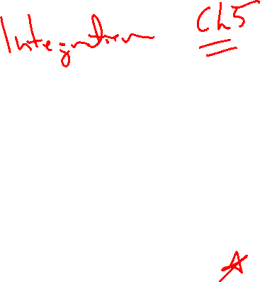
Section 4.9 Antiderivatives
Lecture 1
Reversing differentiation

Slide 2

Homework Submission to Canvas
Preview of section
Skim the section in text and write a short paragraph summary.
Give a bulleted list of all important definitions, theorems, and formulas without details.
Notes on video lectures
Take notes on everything written on slides including all details, worked examples, on-own activities, as well as your own thoughts and questions.
Try on-own activities first, then write down provided solution next to it for comparison.
Worked examples from the text
Write down the problem and attempt without looking at the solution.
Use the solution to write the best explanation you can.
Solutions to textbook exercises
Model approaches and explanations given in the video lectures and textbook examples.
Final reflection of section
List the key takeaways to remember as a bulleted list.
Video reflection (for some sections)
Write a 1 paragraph reflection on the video discussing what you found most interesting or useful.

Slide 3
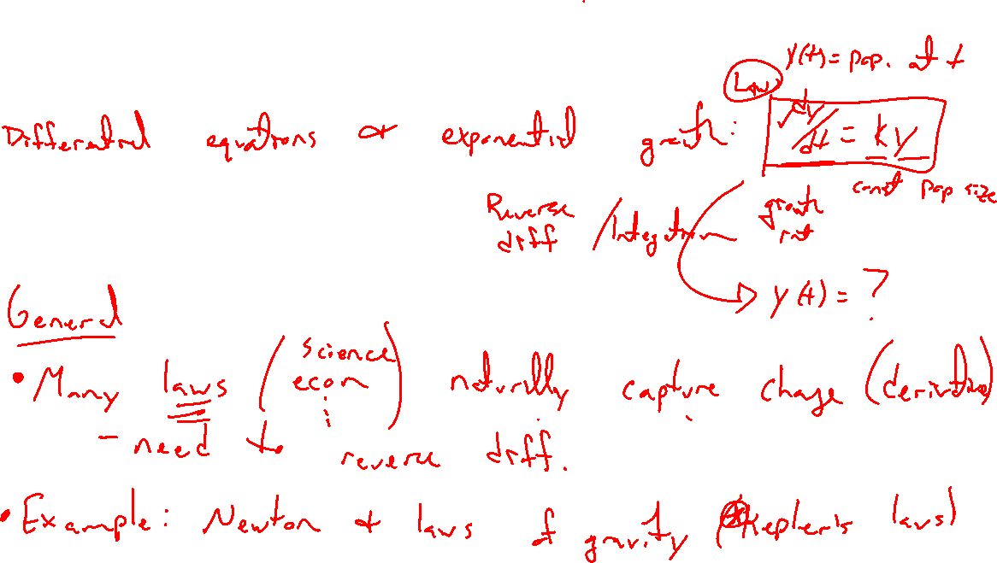
Why reverse differentiation?
Notes:
Many physical laws quantify change, but computing the underlying quantities is most interesting.
Saw this already with DEs for exponential growth.
Newton and Kepler's laws, the spark for calculus

Slide 4
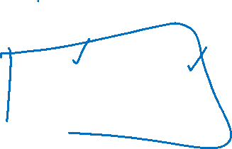
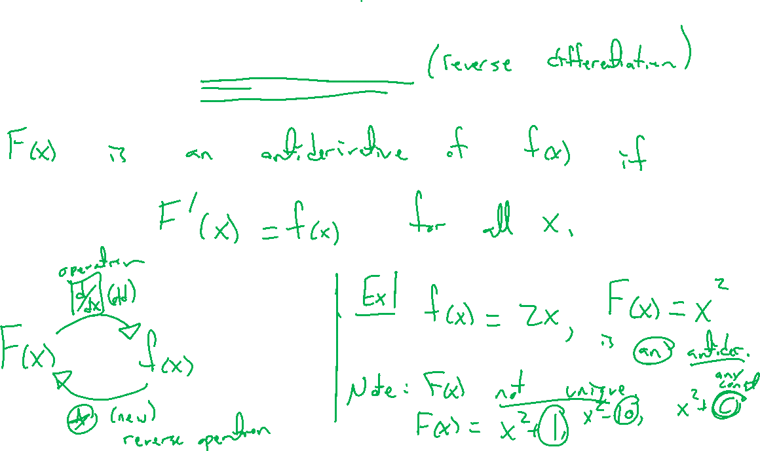
Definition of antiderivative
Notes:
F(x) is an antiderivative of f(x) on interval I if F'(x) = f(x) for all x in I
Example: 2x has antiderivative x^2
Note, not unique here. Any f(x)+C works for C an arbitrary constant.

Slide 5
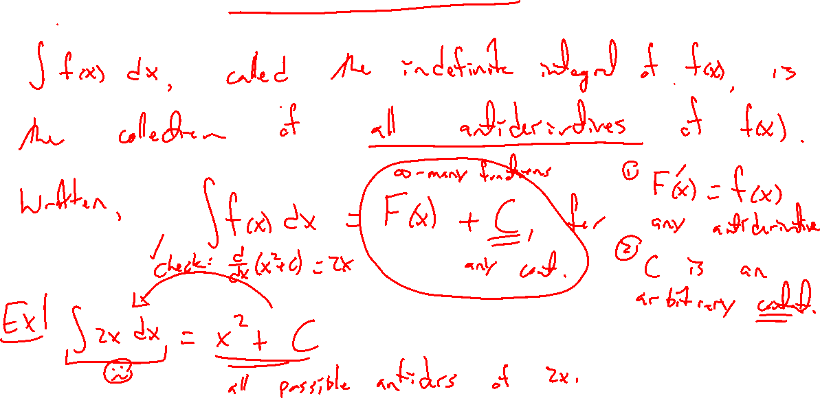
Definition of indefinite integral
Notes:
The collection of all antiderivatives of f(x) is denoted \int f(x) ~dx.
That is, \int f(x) ~dx=F(x)+C where F(x) is any antiderivative and C an arbitrary constant.
Example: \int 2x ~dx

Slide 6
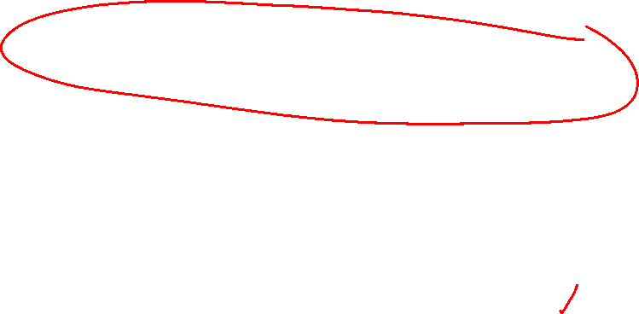

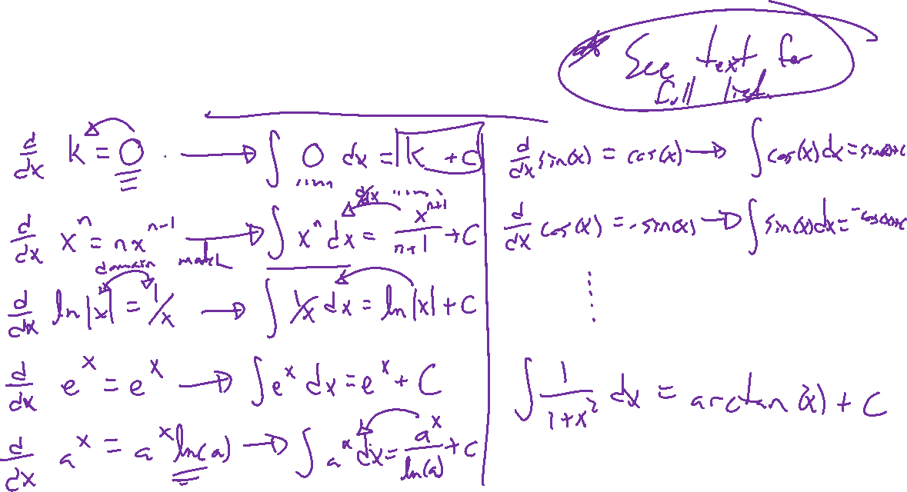
Reversing differentiation rules
Notes:
Linearity
K, x^n, 1/x, \sin(x), \cos(x), \sec^2(x), e^x, a^x, 1/(1+x^2).
Note: Reversing is not easy: \tan(x), \ln(x), \sin(x^2)…..

Slide 7
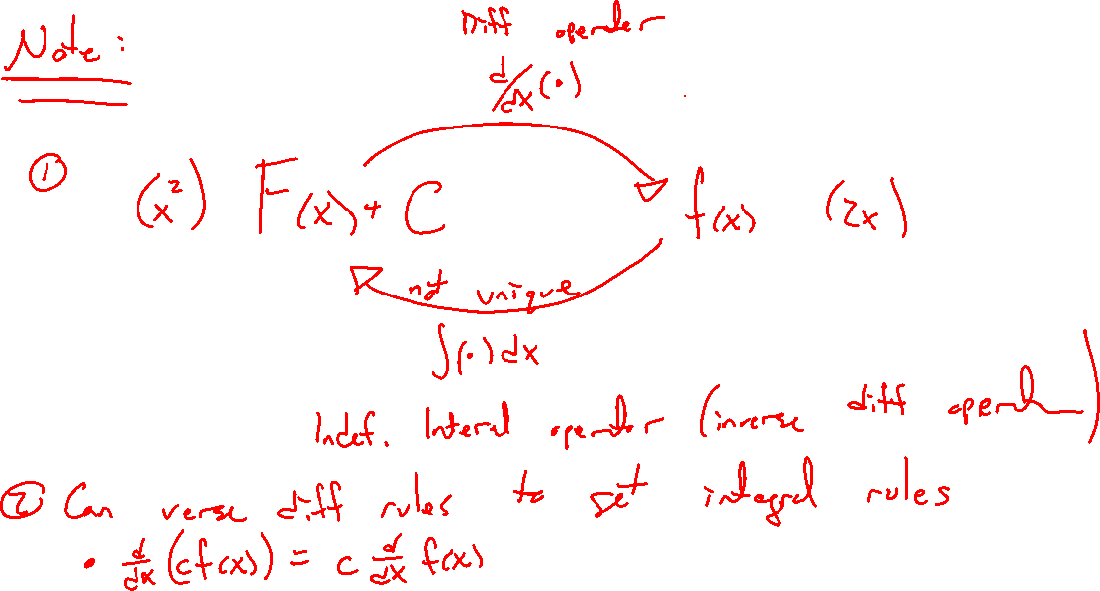
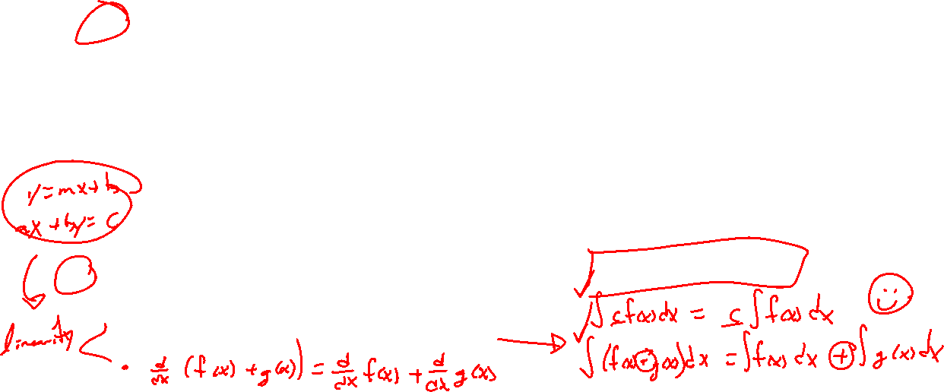

Slide 8
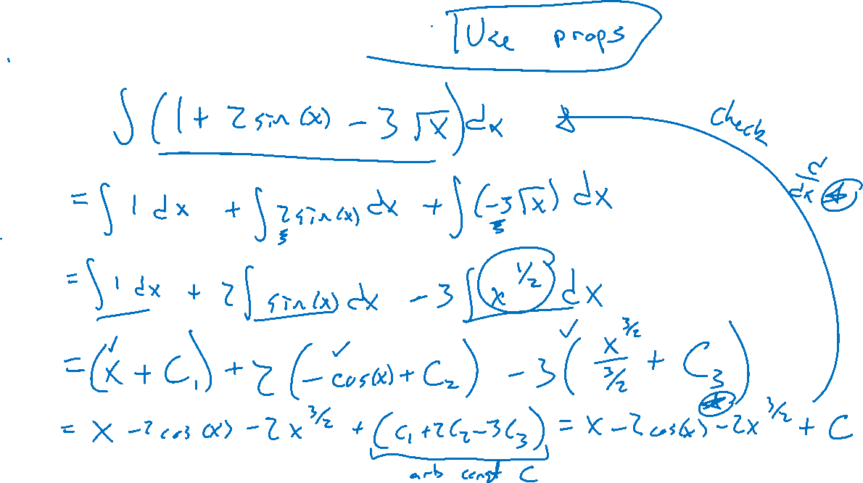
Example: Try on own
Notes:
Compute \int (1+2\sin(x)-3/\sqrt{x} ~dx
Note, if want once answer, need another condition such as F(0)=2.

Slide 9

Textbook Examples and Exercises
Rework examples 2, 3, 4, 5, 7 in the text. Steps:
Write down a problem.
Close the book and attempt on own.
Check / correct your solution against the text solution.
If needed, rewrite the problem to be of the quality of the text solution.
Complete exercises 15, 23, 25, 41, 51
Write solutions of the same quality as in lecture and text solutions.
Check your solution against the answer in the back of the book.
Video reflection
NONE

Slide 10

Homework Submission to Canvas
Preview of section
Skim the section in text and write a short paragraph summary.
Give a bulleted list of all important definitions, theorems, and formulas without details.
Notes on video lectures
Take notes on everything written on slides including all details, worked examples, on-own activities, as well as your own thoughts and questions.
Try on-own activities first, then write down provided solution next to it for comparison.
Worked examples from the text
Write down the problem and attempt without looking at the solution.
Use the solution to write the best explanation you can.
Solutions to textbook exercises
Model approaches and explanations given in the video lectures and textbook examples.
Final reflection of section
List the key takeaways to remember as a bulleted list.
Video reflection (for some sections)
Write a 1 paragraph reflection on the video discussing what you found most interesting or useful.

